Slide 1
Deep learning short course
Chapter 1. Introduction to Deep Learning

Slide 2
Content
1 Applications of deep learning
2 Modern deep learning structures
3 Deep learning theory

Slide 3
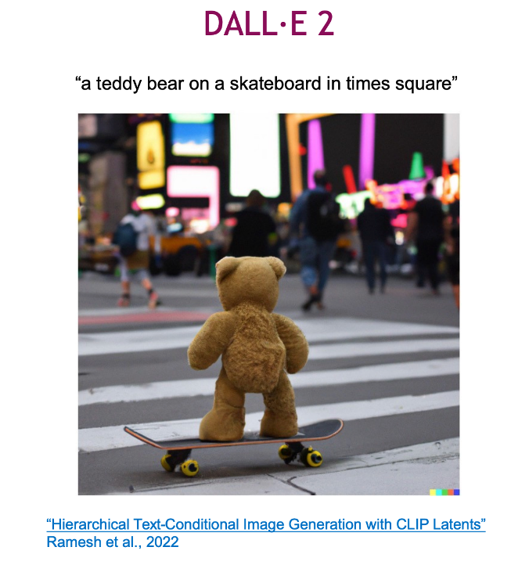
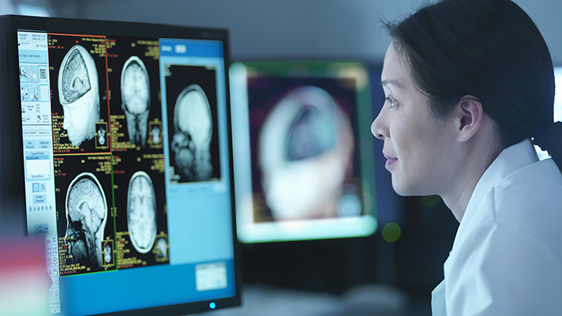
Applications - Vision
High quality image generalization
Disease Detection in Healthcare and Medicine
Deep learning can be utilized for early and more accurate detection of diseases like cancer, Alzheimer's, and heart diseases through image analysis.

Slide 4
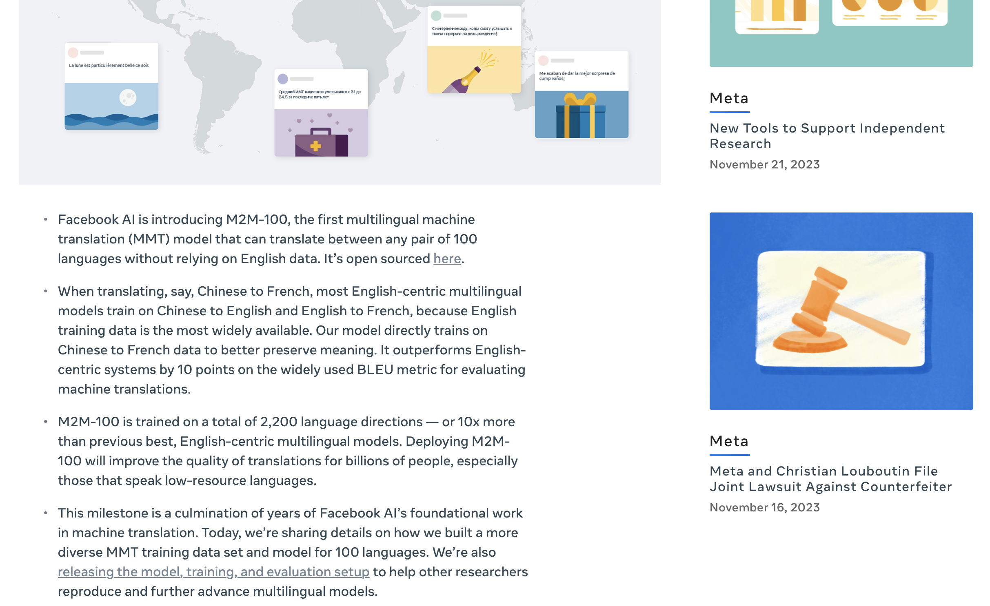
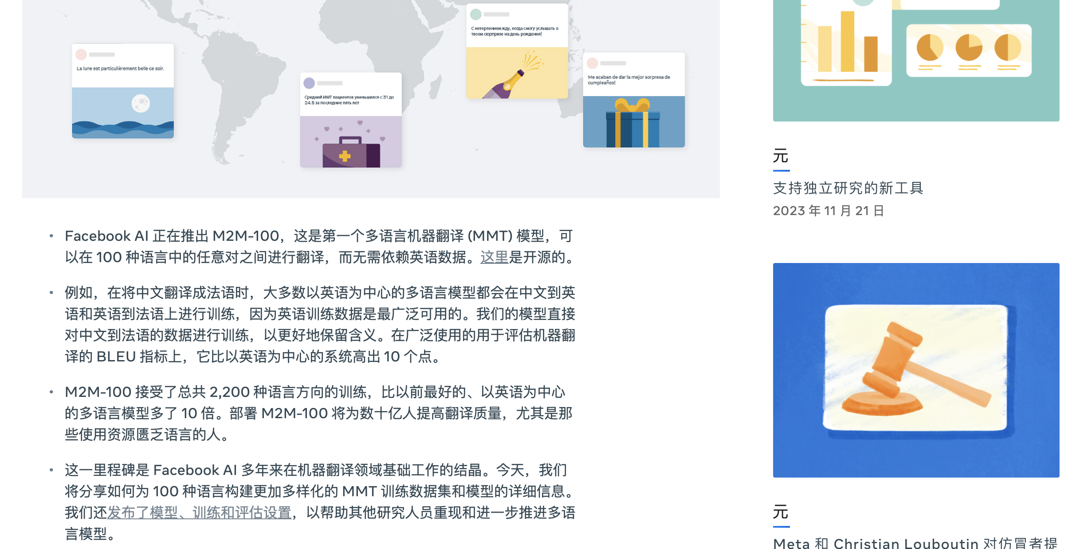
Application - Language
Language Translation in Natural Language Processing
Deep learning enhances real-time, accurate translation of languages, as seen in tools like Google Translate. The following picture shows the translation of a webpage from English to Chinese.

Slide 5
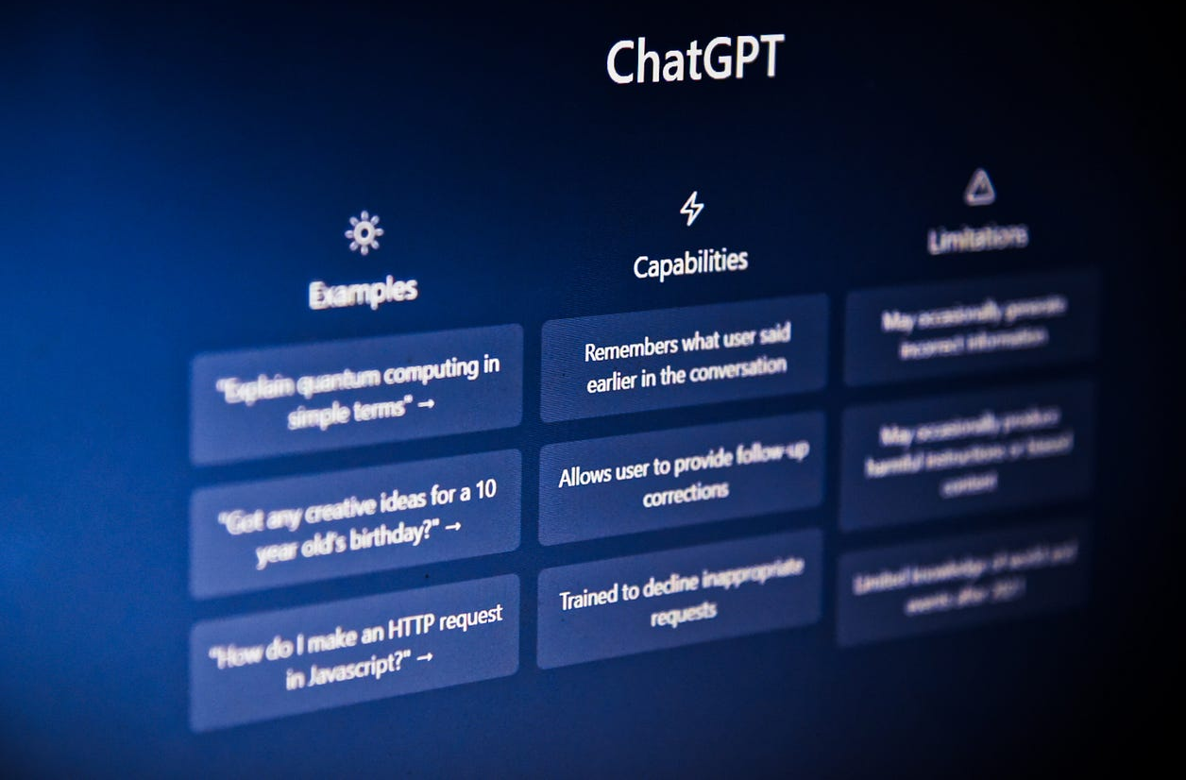
Application - Language
Large language models
Large language models can perform various tasks such as answering questions, generating creative content, summarizing text, translating languages, and engaging in conversations. It’s designed to understand and generate text in a coherent and contextually relevant manner.

Slide 6
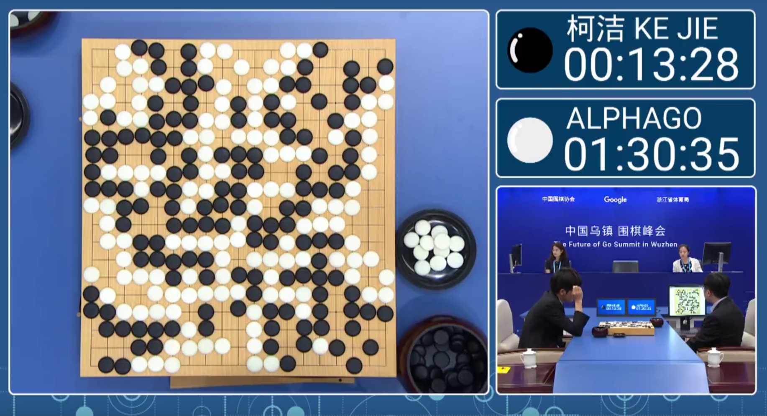
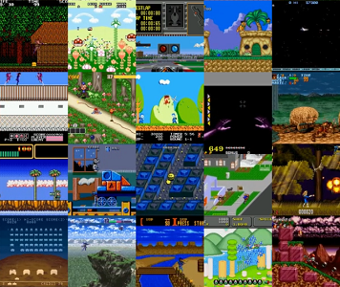
Application - decision
March 2016, AlphaGo made headlines by defeating Lee Sedol.
Reinforcement learning methods have shown priority in video games.

Slide 7

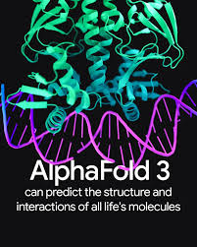
Application - more
Personalized Shopping Experience in Retail and E-Commerce
Predict the folding and 3D structure of protein
Deep learning is leveraged to provide personalized recommendations and targeted advertising to customers based on their shopping behavior.
AlphaFold aims to solve the protein folding problem, which involves predicting a protein's three-dimensional structure based solely on its amino acid sequence. Understanding protein structures is crucial for biological research and drug discovery.

Slide 8

What Exactly is Deep Learning?

Slide 9
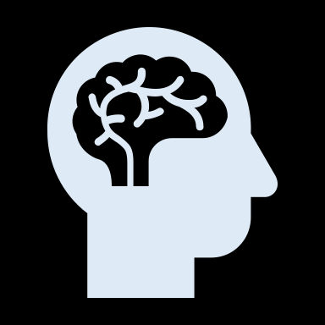






Key Terminologies
Artificial Intelligence
Simulates human intelligence in machines for tasks like decision-making and language translation.
Machine Learning (ML)
A subset of AI where algorithms learn from data to make predictions or decisions without being explicitly programmed for each scenario.
Deep Learning (DL)
A branch of machine learning using multi-layered neural networks, effective in processing large amounts of unstructured data like images and speech.
Generative AI
AI algorithms that generate new, original content (like text or images) based on existing data, using techniques like Generative Adversarial Networks (GANs).

Slide 10
Deep Learning
Deep learning is a subset of machine learning that focuses on training artificial neural networks to perform tasks. Its algorithms were inspired by the working of the human brain.
It‘s characterized by the use of multiple layers (deep architectures) that allow networks (neural networks) to learn hierarchical representations of data and to learn to complete specific tasks.
In contrast to traditional machine learning, which often requires manual feature extraction, deep learning can automatically learn features from raw data, which you can think of as patterns that occur within the data.
Deep learning can be used for supervised, unsupervised as well as reinforcement machine learning.
Objective: teaching computer how to learn a task directly from raw data
Notes:
https://www.youtube.com/watch?v=QDX-1M5Nj7s&list=PLtBw6njQRU-rwp5__7C0oIVt26ZgjG9NI

Slide 11
Content
1 Applications of deep learning
2 Modern deep learning structures
3 Deep learning theory

Slide 12
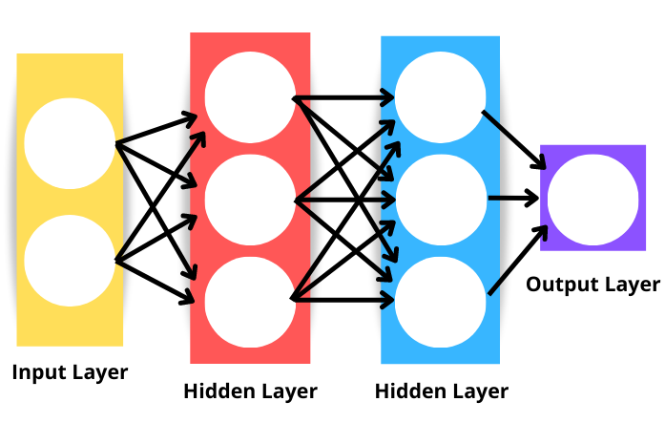
Backbone of Deep Learning - Neural Networks
Neural networks, also called artificial neural networks (ANNs) or simulated neural networks (SNNs), are a subset of machine learning and are the backbone of deep learning algorithms.
The neural network is inspired by the human brain’s interconnected neurons. They are called “neural” because they mimic how neurons in the brain signal one another.
It consists of layers: an input layer, one or more hidden layers, and an output layer.
The “deep” in deep learning refers to the depth of layers in a neural network.
Usually, a neural network of more than three layers, including the inputs and the output, can be considered a deep-learning algorithm.
Further details on neural networks will be in upcoming courses.
Notes:
https://www.ibm.com/blog/ai-vs-machine-learning-vs-deep-learning-vs-neural-networks/#
Figure from: https://www.datacamp.com/tutorial/pytorch-tutorial-building-a-simple-neural-network-from-scratch

Slide 13

Some Classic DL Model Architectures
1
Convolutional Neural Networks (CNNs)
Key Features: Utilizes convolutional layers to process data in a grid pattern (like images).
Key Components:
Convolutional Layers: Extract features from input images using filters.
Pooling Layers: Reduce dimensions and computational load, retaining key information.
Fully Connected Layers: Classify images based on extracted features.
Example Models: LeNet-5, AlexNet, VGGNet.
Figure. Basic CNN structure.
Applications in Biomedicine:
Image classification in diagnostics (e.g., cancer detection from scans).
Image segmentation for identifying regions of interest in medical images.
Notes:
Ref: https://www.upgrad.com/blog/basic-cnn-architecture/
https://medium.com/techiepedia/binary-image-classifier-cnn-using-tensorflow-a3f5d6746697

Slide 14
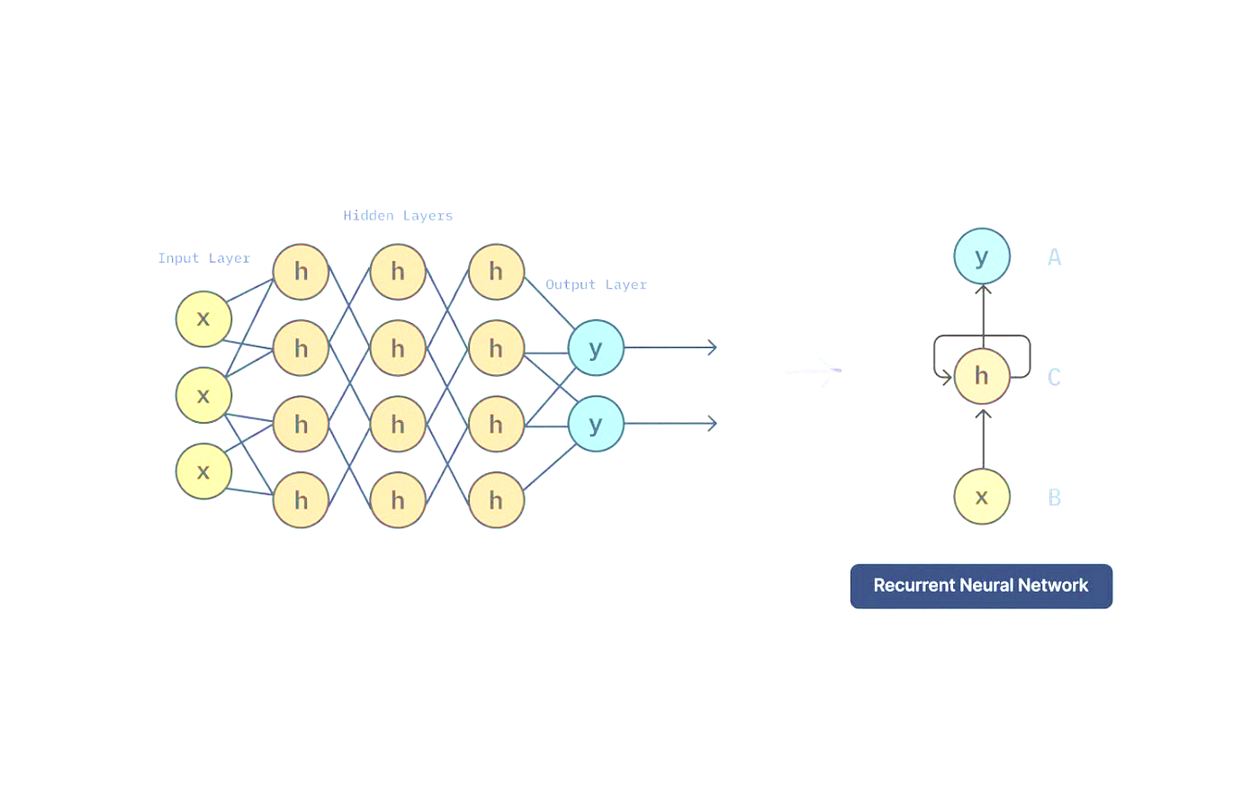
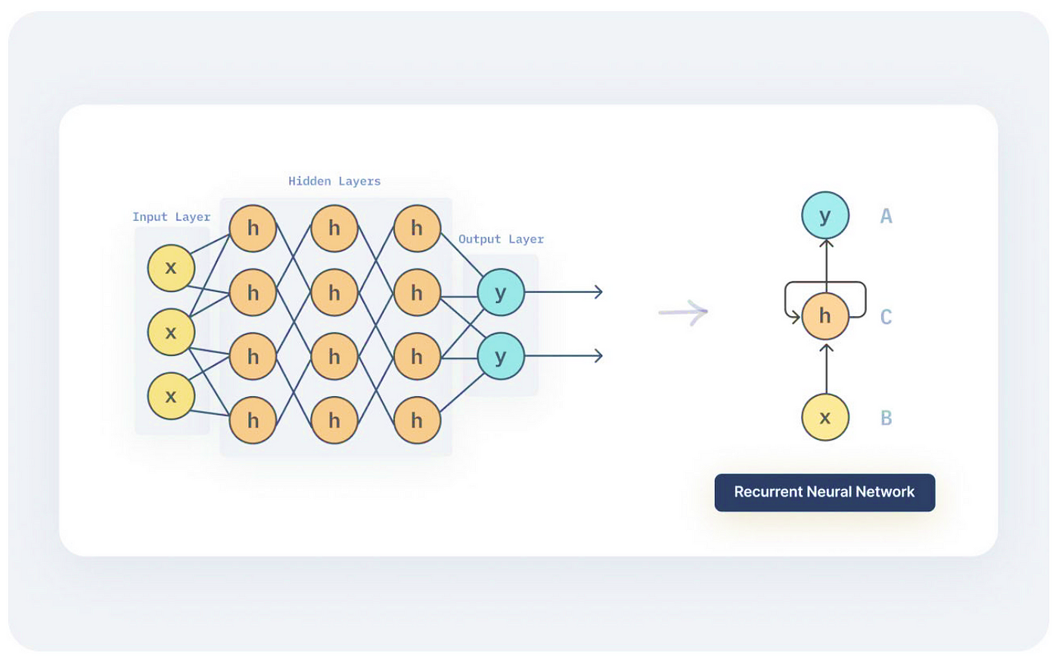

Some Classic DL Model Architectures
2
Recurrent Neural Networks (RNNs)
Key Features: Processes sequences of data (time-series data), with memory of previous inputs, capturing temporal dynamics.
Unique Feature: Loop-like architecture allowing previous outputs to be used as inputs while having hidden states, enabling information persistence.
Challenges & Solutions: Problem of vanishing gradients; solved by advanced RNNs, e.g. LSTM and GRU.
Example Models: LSTM (Long Short-Term Memory), GRU (Gated Recurrent Unit).
Applications in Biomedicine:
Analysis of sequential patient data in EHRs.
Time-series analysis in physiological signal processing.
Notes:
Ref: https://stanford.edu/~shervine/teaching/cs-230/cheatsheet-recurrent-neural-networks
https://www.analyticsvidhya.com/blog/2022/03/a-brief-overview-of-recurrent-neural-networks-rnn/

Slide 15
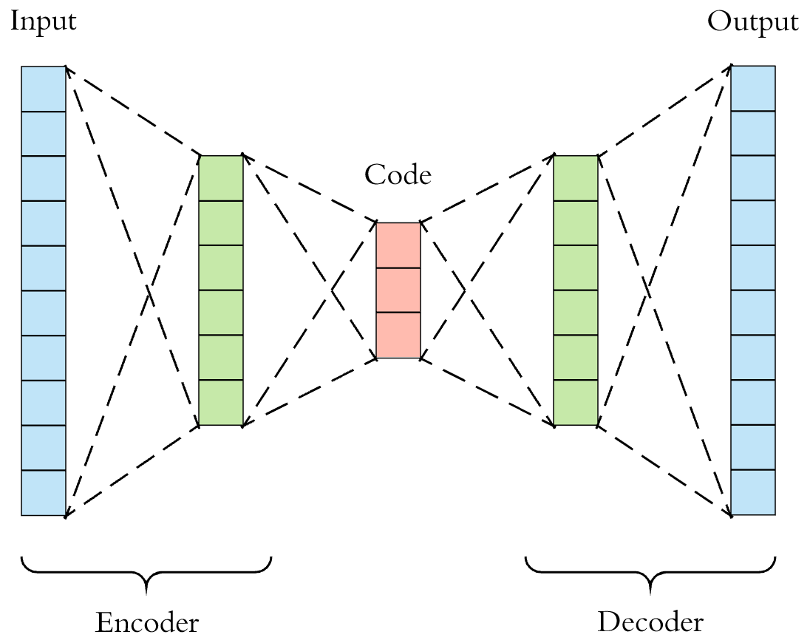
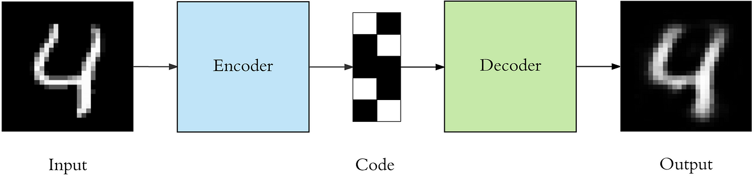
Some Classic DL Model Architectures
3
Autoencoders
Key Features: Unsupervised learning models for dimensionality reduction and feature learning.
Structure: Composed of an encoder (compressing input) and a decoder (reconstructing input).
Types: Standard Autoencoders, Variational Autoencoders (VAEs).
Applications in Biomedicine:
Data denoising (e.g., removing noise from images).
Anomaly detection in medical imaging (e.g., identifying unusual patterns).
Figure 1. Visualization of an autoencoder
Figure 2. Autoencoders are a specific type of feedforward neural networks where the input is the same as the output.
Notes:
Ref: https://towardsdatascience.com/applied-deep-learning-part-3-autoencoders-1c083af4d798

Slide 16
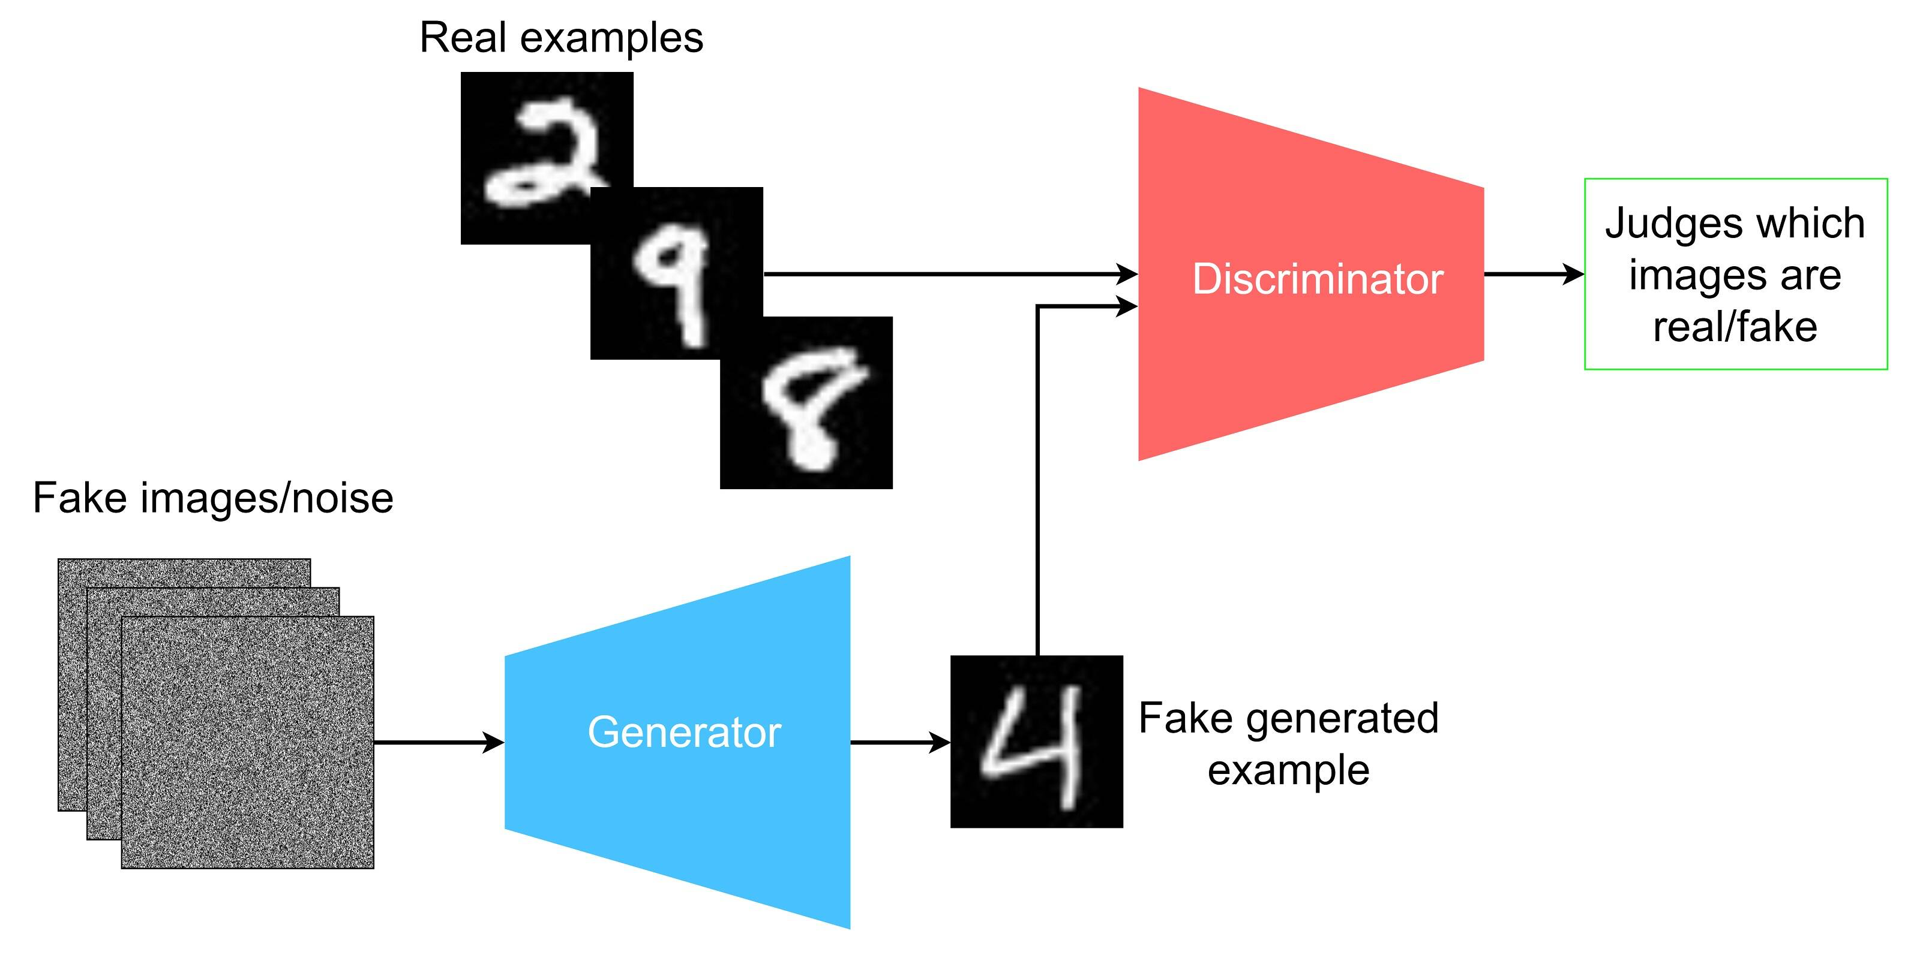
Some Classic DL Model Architectures
4
Generative Adversarial Networks (GANs)
Key Features: Comprises two neural networks, a generator and a discriminator, competing against each other.
Mechanism:
Generator creates images, trying to fool the discriminator by generating data similar to those in the training set.
Discriminator evaluates them, trying to distinguish between fake data and real data
Example Models: DCGAN, Pix2Pix, CycleGAN.
Figure. Visualization of the flow of GAN
Applications in Biomedicine:
Generate high-resolution images from low-resolution inputs, enabling improved image quality.
Data augmentation in medical imaging for robust model training.
Notes:
Ref: https://developer.ibm.com/articles/generative-adversarial-networks-explained/

Slide 17

Some Classic DL Model Architectures
5
Transformer Models
Key Features: Utilizes self-attention mechanisms, excellent for handling sequences of data.
Key Innovation: Following an encoder-decoder structure, eliminating recurrence and convolutions.
Example Models: BERT (adapted for biomedical applications), AlphaFold.
Applications in Biomedicine:
Genomic sequence analysis for personalized medicine.
Protein structure prediction (e.g., AlphaFold's breakthroughs).
Figure. Transformer architecture
Notes:
Ref: https://machinelearningmastery.com/the-transformer-model/

Slide 18
Types of Deep Learning
Deep Learning
Unsupervised Learning
The neural network learns to discover the patterns or to cluster the dataset based on unlabeled datasets. There are no target variables.
Generative Model
DDPG
CNN
…
Autoencoders
Supervised Learning
An agent learns to make decisions in an environment to maximize a reward signal. The agent interacts with the environment by taking action and observing the resulting rewards.
Reinforcement Learning
…
RNN
…
Neural network learns to make predictions or classify data based on the labeled datasets.
Deep Q Network

Slide 19
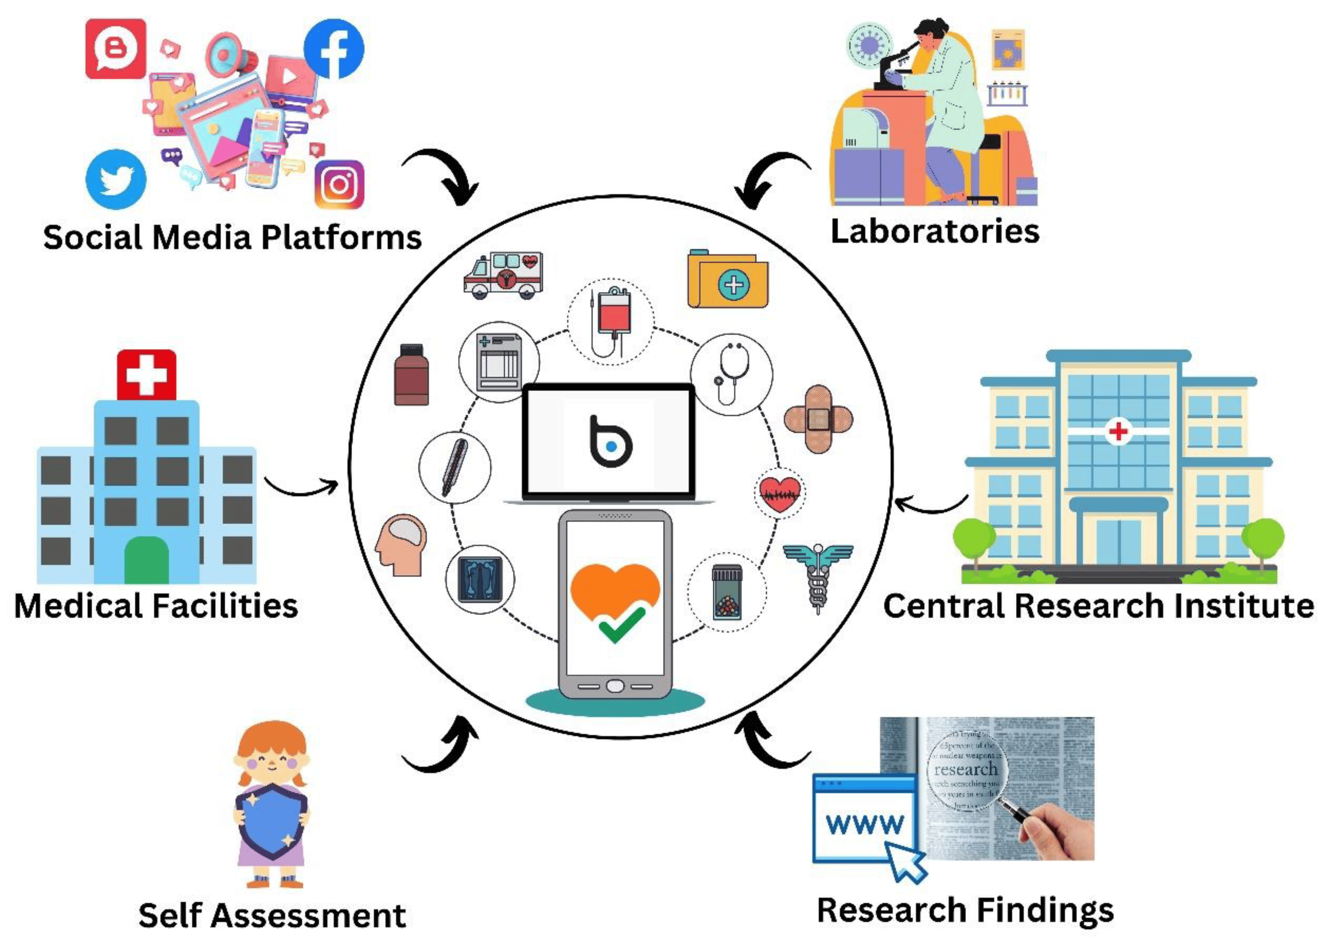
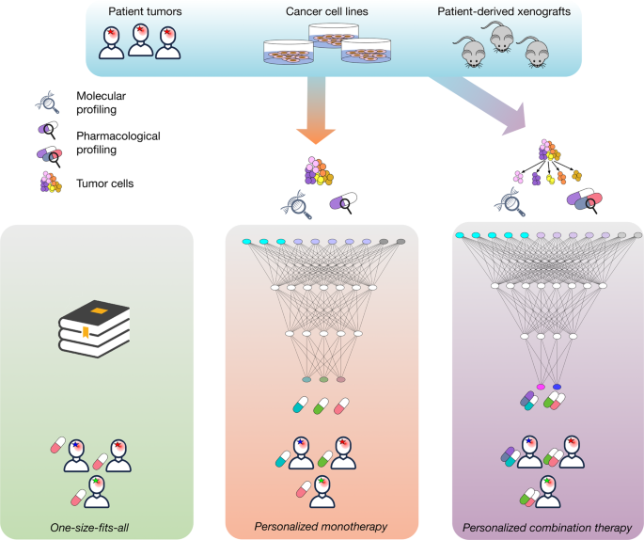
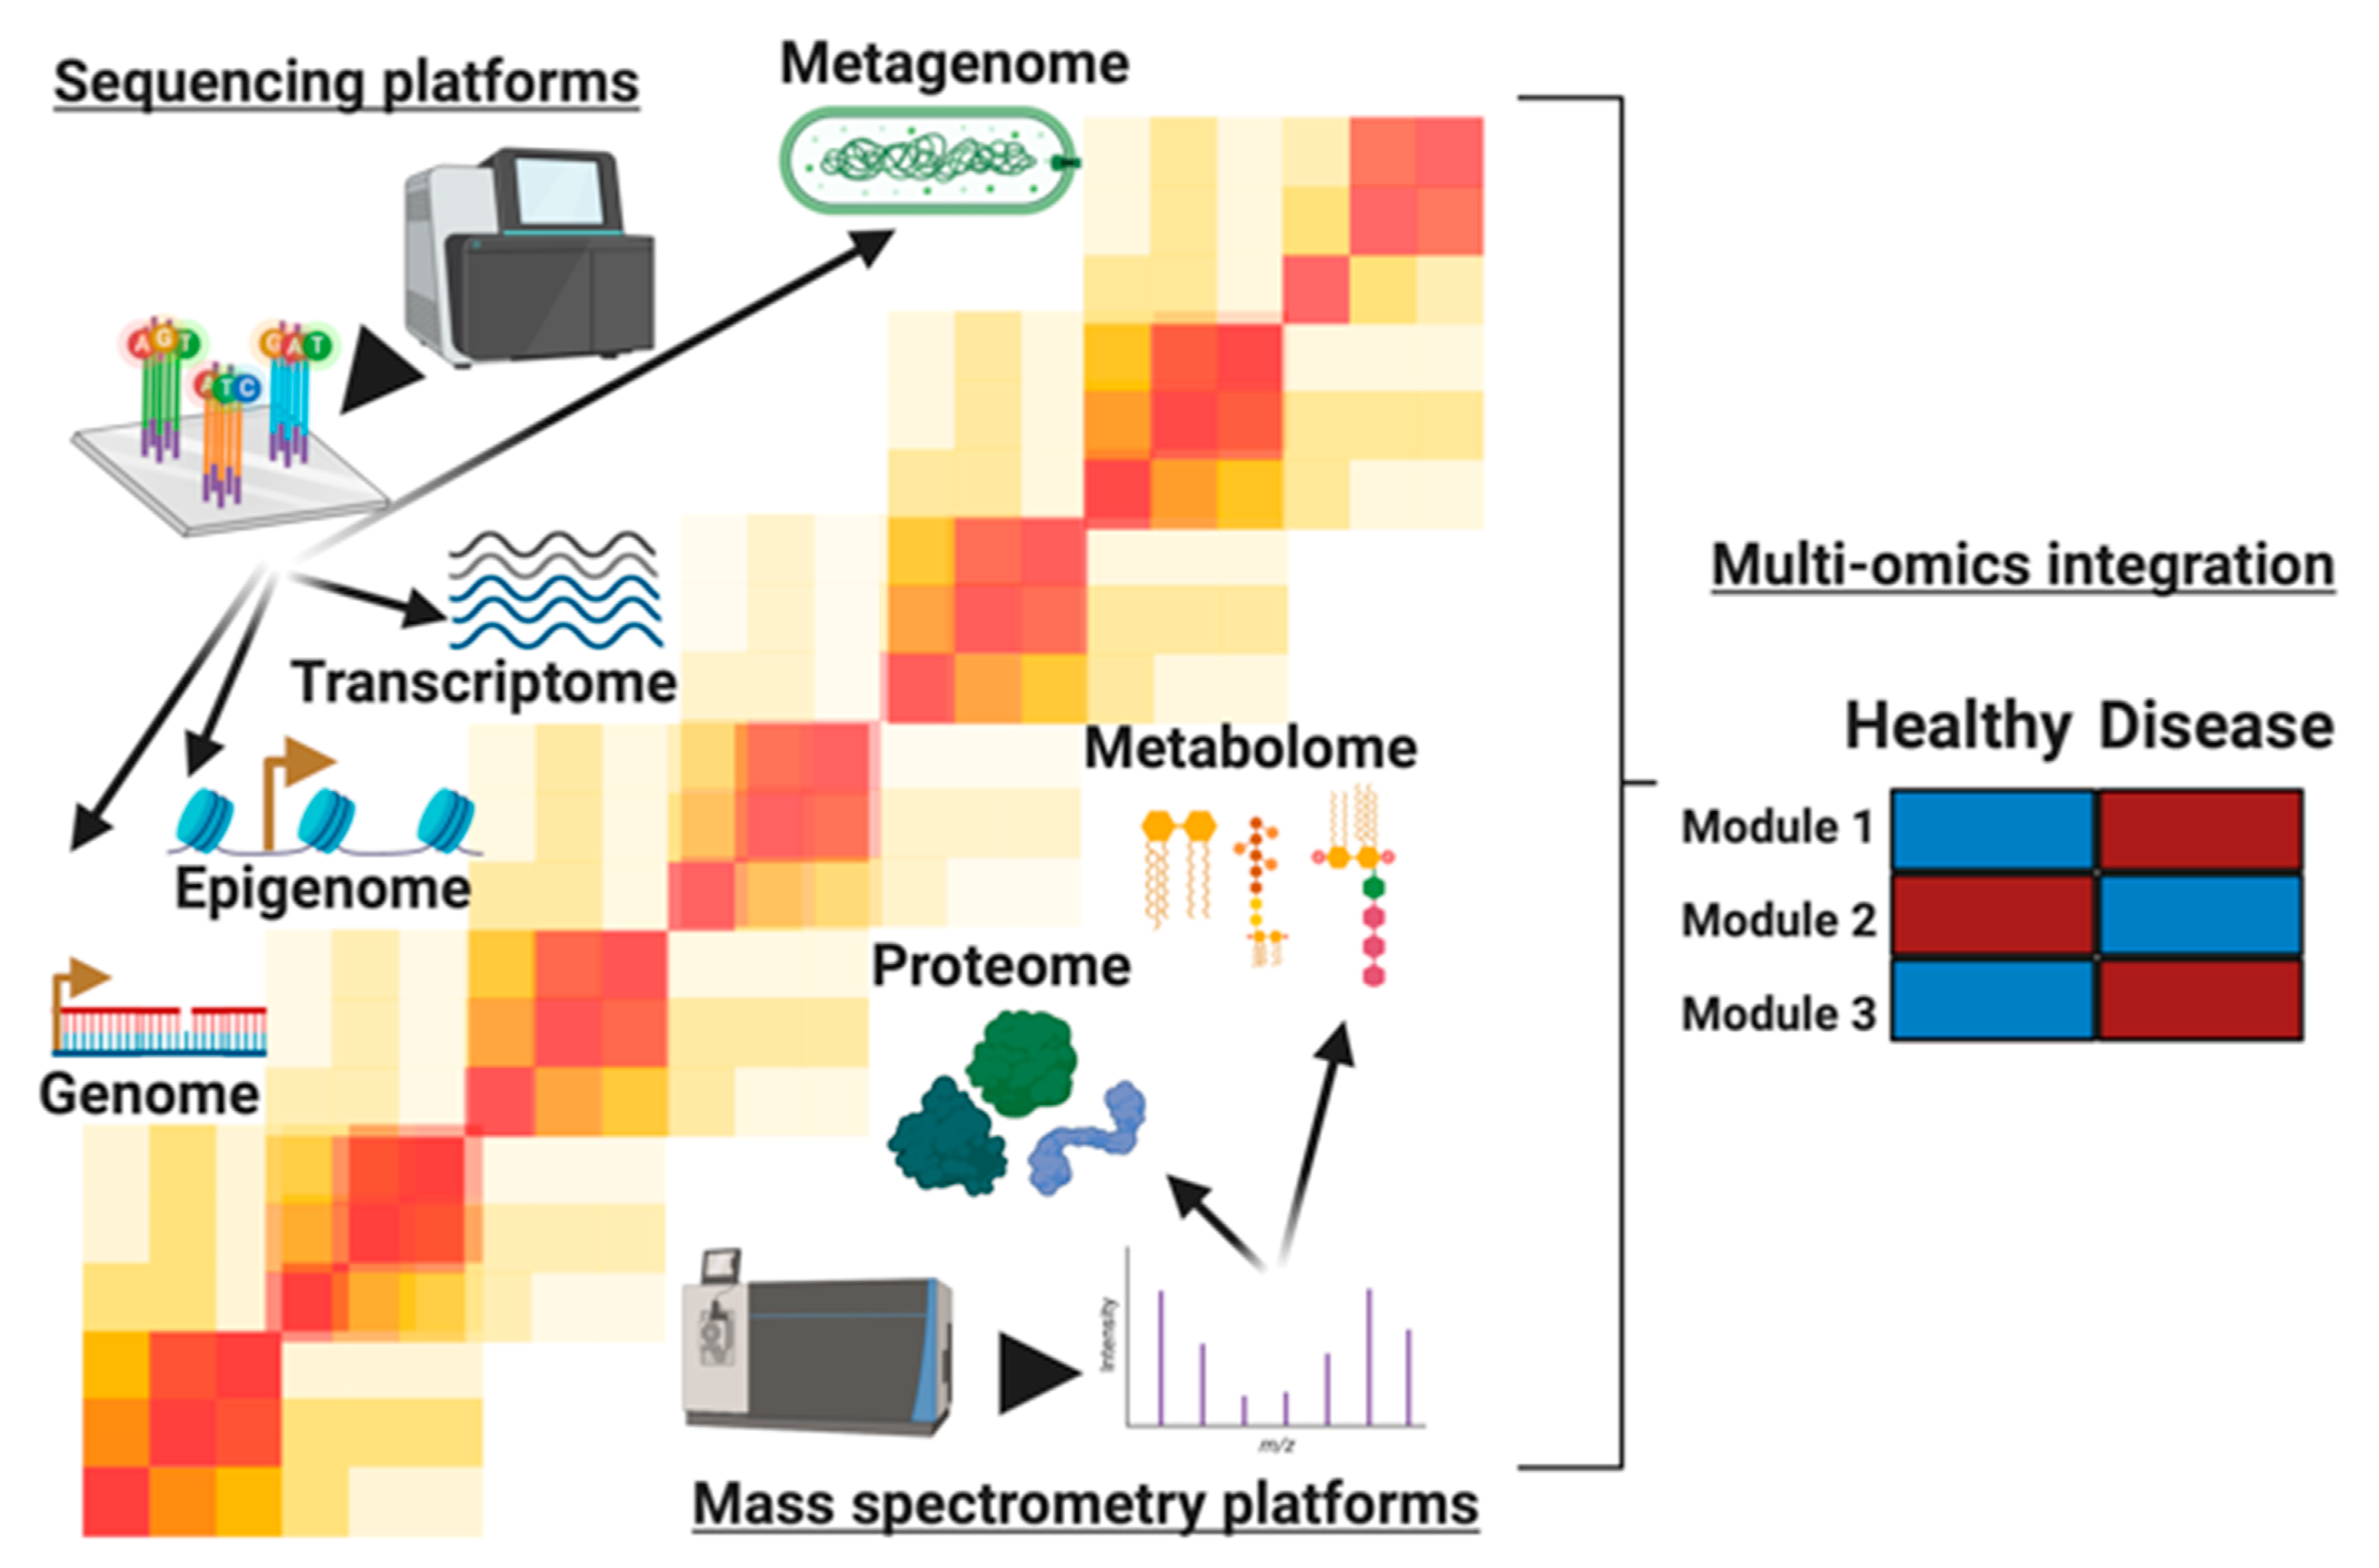
Some Future Directions in DL for Biostatistics
AI-driven Public Health Interventions
Advanced Drug Response Modeling
Integrative Analysis of Multi-omic Data
Utilizing deep learning models to analyze large-scale public health data for informed decision-making and policy development. Allowing better resource allocation, and more effective epidemic control strategies.
Using deep learning to model and predict individual responses to drugs, considering genetic, environmental, and lifestyle factors. Developing more effective personalized treatments.
Leveraging deep learning to integrate and analyze data from genomics, proteomics, metabolomics, and other omics fields for a comprehensive understanding of biological processes and disease mechanisms.
Notes:
Figure 1 ref: https://www.mdpi.com/2076-393X/11/7/1154
Figure 2 ref: https://www.nature.com/articles/s41698-020-0122-1
Figure 3 ref: https://www.mdpi.com/2218-273X/10/12/1606

Slide 20





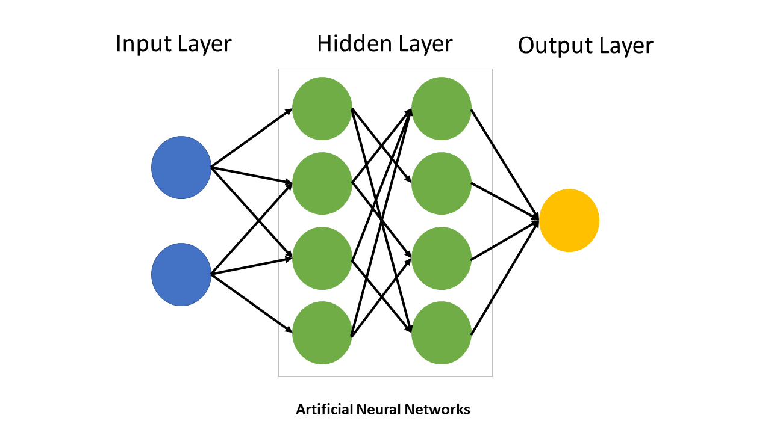
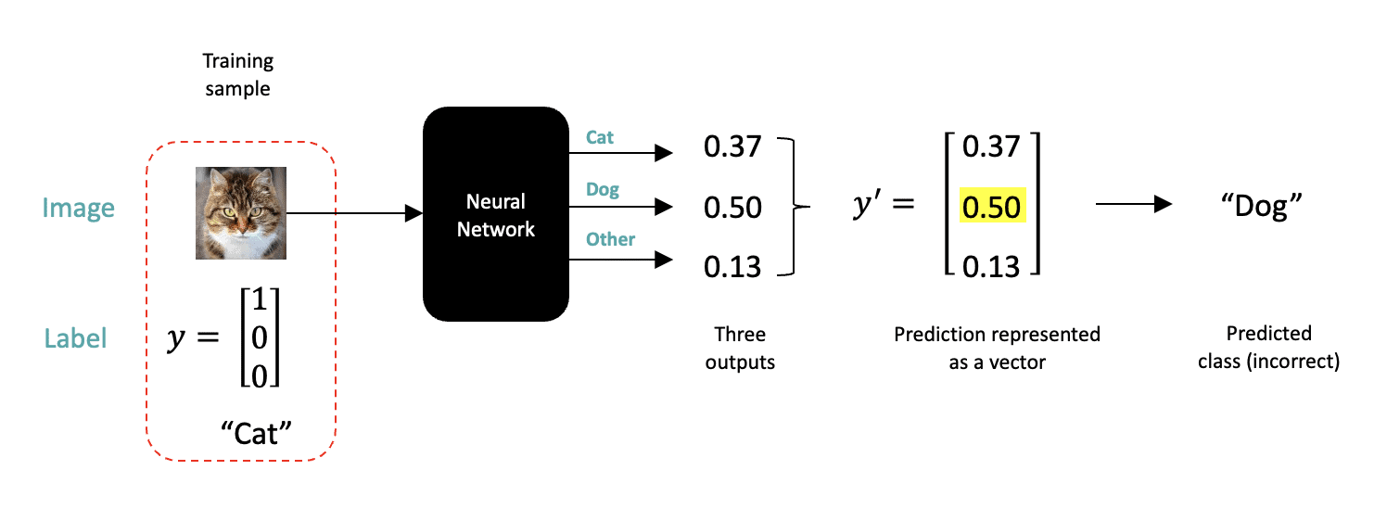
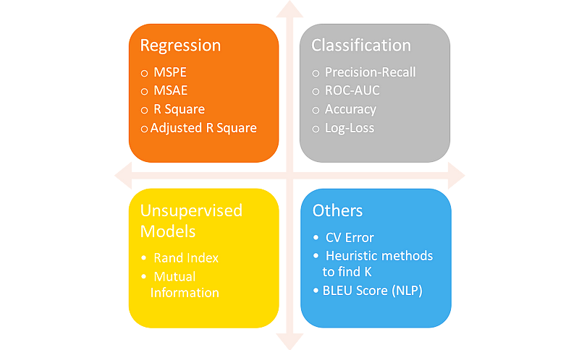


Workflow of a Typical Deep Learning Project
Data Preprocessing
Training Dataset
Modeling
Cleaning Data
60% ~ 80%
Define model architecture and hyperparameter
Scaling Numeric Features
Validation Dataset
Data Acquisition
20%~10%
Public Datasets
Databases
Web-scraping
Crowd Labeling
Test Dataset
Handling Categorical Data & text
20%~10%
Splitting Data
Understand Problem
Train on training dataset
Hyperparameter Tuning
Unsatisfactory
Tune hyperparameters
Tweak architecture
Add regularization
Study why the model is struggling
Model Evaluation
Deployment
Acceptable
Notes:
https://www.codecademy.com/article/deep-learning-workflow

Slide 21
Content
1 Applications of deep learning
2 Modern deep learning structures
3 Deep learning theory

Slide 22
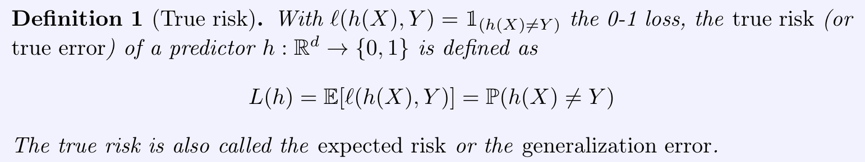
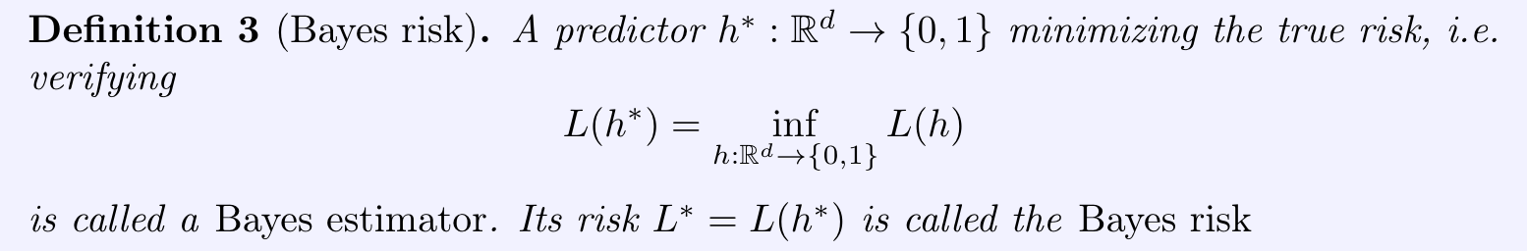
Deep learning theory – Empirical process
Bounding generalization error (understand how well the model can behave) has always be a key topic in learning theory.
Bounding generalization error (understand how well the model can behave) has always be a key topic in learning theory.

Slide 23
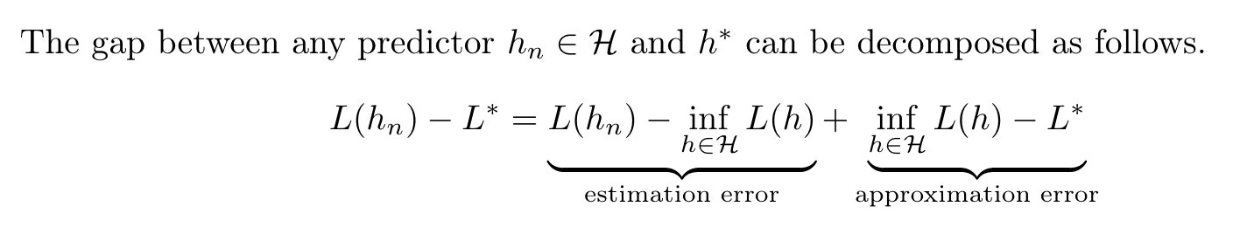
Deep learning theory – Empirical process
It is important to bound the excess risk(how well our model can behave comparing to the Bayes estimator)
It is standard approach to do the following excess risk decomposition.
By empirical process, the estimation error can be bounded with some complexity measure(VC dimension / Rademacher complexity) for the function class.
The approximation error are guaranteed to be bounded by the uniform approximation property of neural networks.

Slide 24
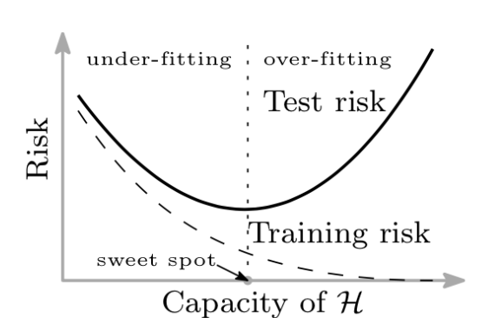
Deep learning theory – Empirical process
By the view of traditional statistical learning, the estimation risk will be higher for more complex model and will increase when the model is bigger. Leading to the classical bias-variance trade-off or U-shape loss curve.
But can this theory explain modern deep learning like LLMs?

Slide 25
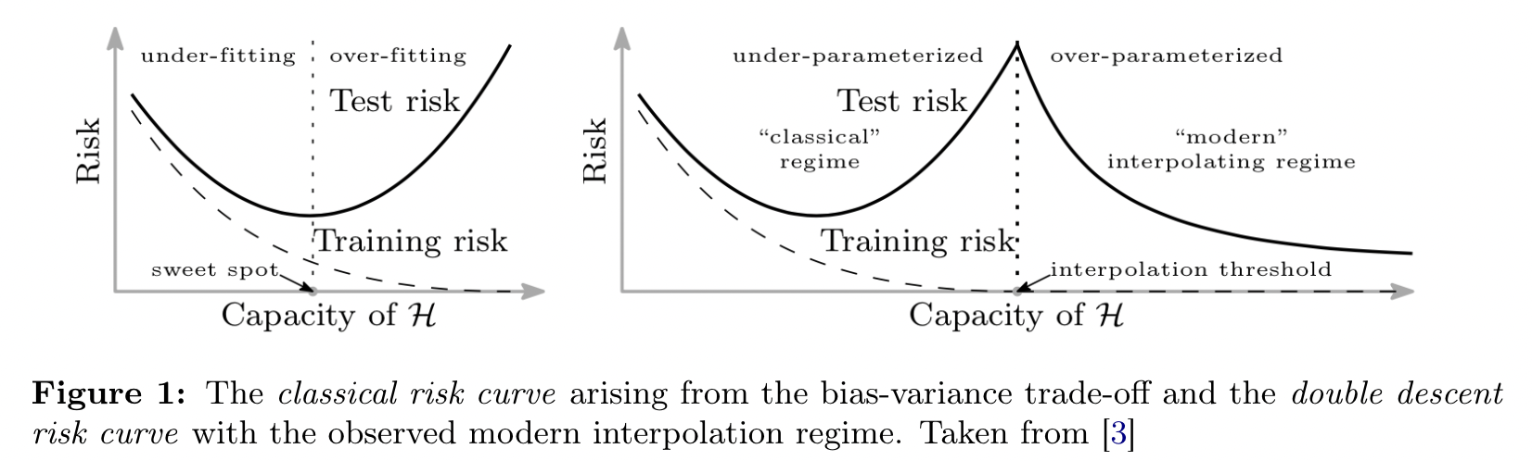
Double descent and scaling law
It is generally observed that with model size increasing, excess risk first decrease and then increase. But after reaching the interpolation threshold, the excess risk decrease again which cannot be explained by traditional empirical process based theories.

Slide 26
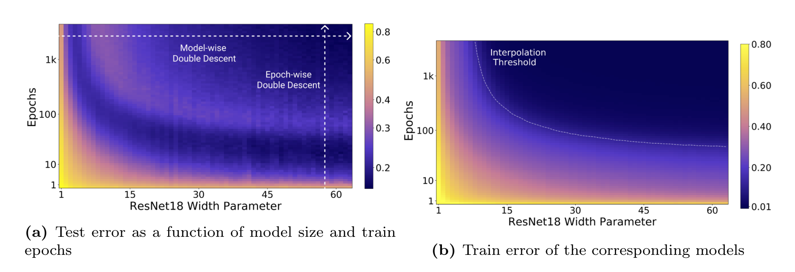
Double descent and scaling law
The double decent phenomenon happen in two way: Epoch wise and model wise.

Slide 27
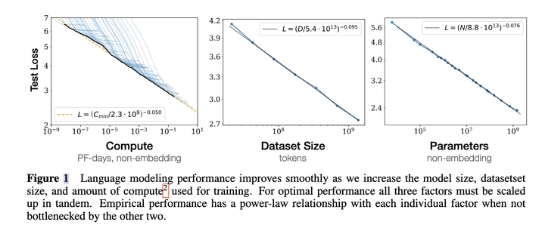
Double descent and scaling law
The scaling law of large language models was first proposed by OpenAI in 2020.
Its observed that the capability of LLMs mostly depends on the Compute, Data size and Number of parameters.

Slide 28
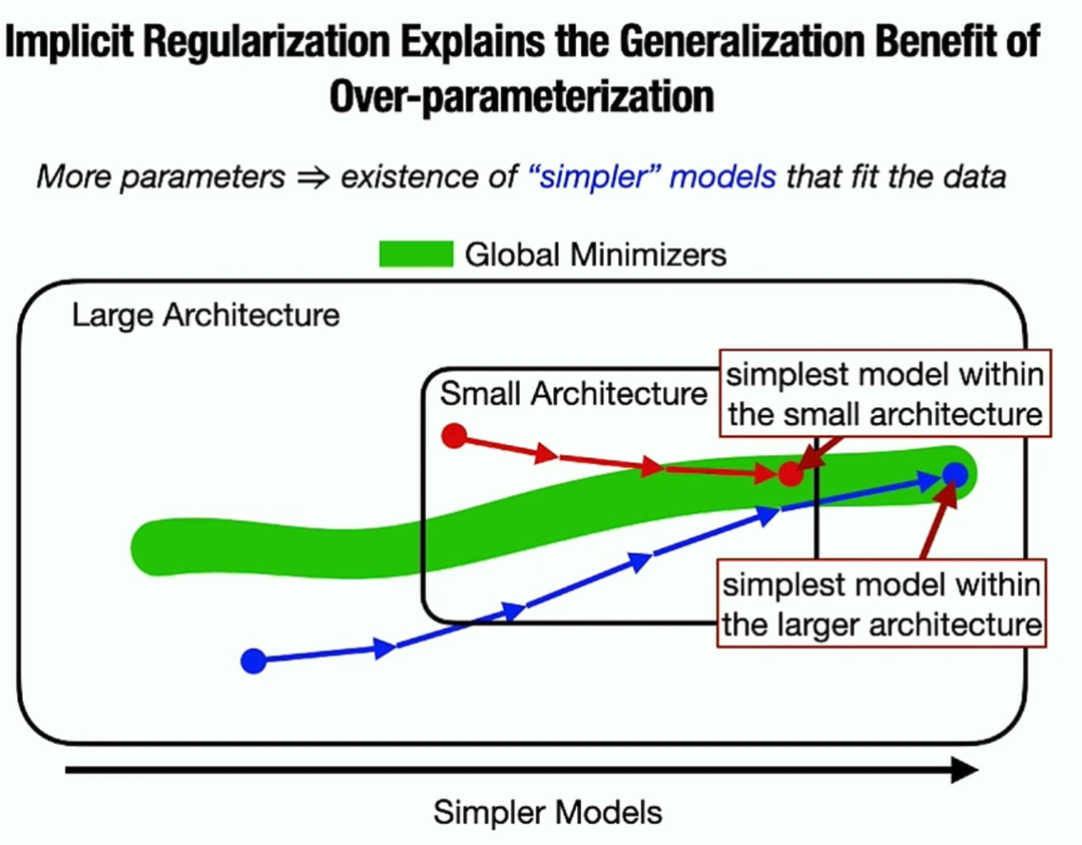
Why larger model behave better
Modern deep learning models are overparametrized models, thus exists many interpolators / global minima.
Modern optimizing strategy (even SGD) have certain preference to global minima that have certain promising properties (e.g flat minima, max margin, small norm).
These global minima may lead to better generalization property
Small function class cannot cover those models with good generalization behavior.

Slide 29
Theory -reference
Recent Advances in the Generalization Theory of Neural Networks – ICML2023 Tutorial
Understanding the Double Descent Phenomenon in Deep Learning
Nagarajan, Vaishnavh, and J. Zico Kolter. "Uniform convergence may be unable to explain generalization in deep learning." Advances in Neural Information Processing Systems 32 (2019).
Belkin, M., et al. "Reconciling modern machine learning practice and the bias-variance trade-off, arXiv." arXiv preprint arXiv:1812.11118 10 (2019).
Kaplan, Jared, et al. "Scaling laws for neural language models." arXiv preprint arXiv:2001.08361 (2020).

Slide 30
Class Schedule
Moring Session
Introduction to Deep Learning (Hongtu Zhu)
Introduction to Deep Learning Packages/resources (Runpeng Dai)
Deep Generative Models (Xiao Wang)
Afternoon Session
Transformer and self-supervised learning (Xiao Wang)
Survival Analysis with Deep Learning and Deep Quantile Regression (Hongtu Zhu)
Time Series and Spatial-Temporal Data Modeling (Runpeng Dai)
Notes:
Change the specific schedule

Slide 31
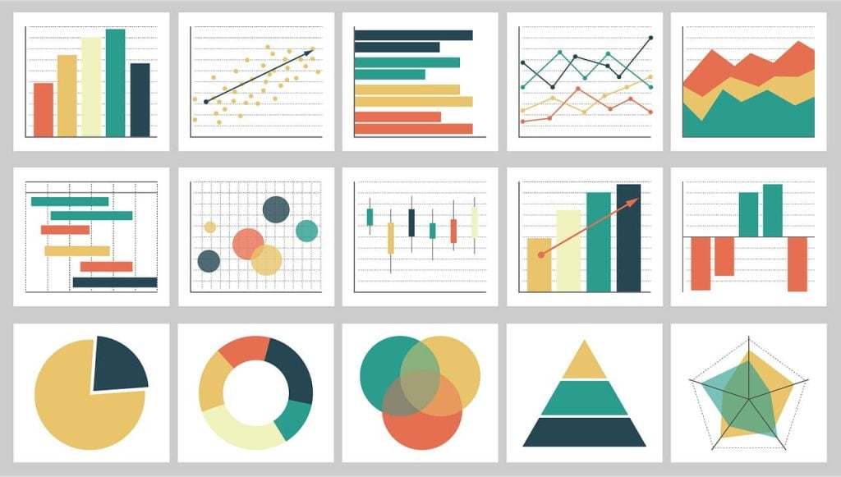
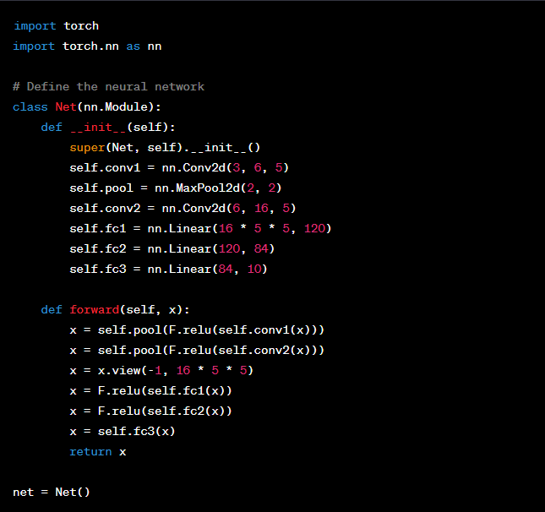

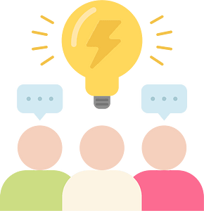

How to succeed in this course?
Visualize
Practice
Explore
Discuss
Ask

